Slide 1
Webhead & Workforce Development Boards
www.webheadtech.com

Slide 2
ABOUT US…

Slide 3
Celebrating 25 Years in Business
Founded at the advent of the Internet in 1994 by 3 UTSA graduates
Woman, minority-owned certified business
Corporate headquarters in San Antonio with a facility security clearance level (TS FCL) with secret processing at site location
45+ employees nationwide, 75% hold security clearances, 95% STEM degrees
Recognized by Industry for: Growth, as a top development company and best places to work

Slide 4
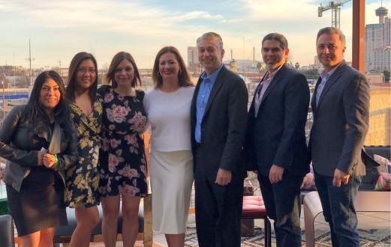
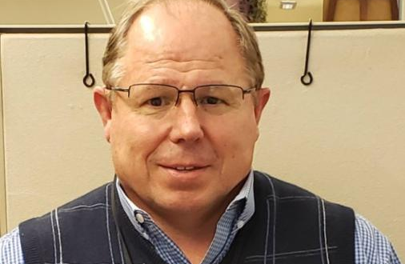
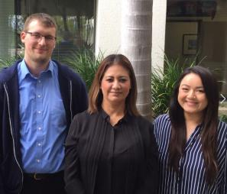

Slide 5
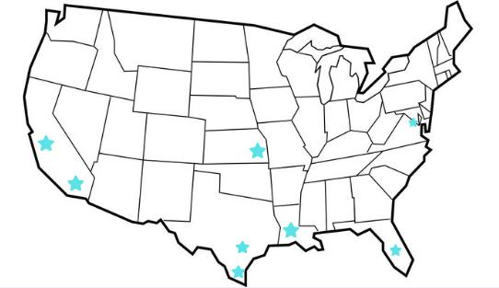
PROUDLY SERVING OUR CLIENTS FROM ACROSS THE NATION…

Slide 6
OUR EXPERIENCE WITH WORKFORCES…

Slide 8
services…

Slide 10
Latest trends…

Slide 11
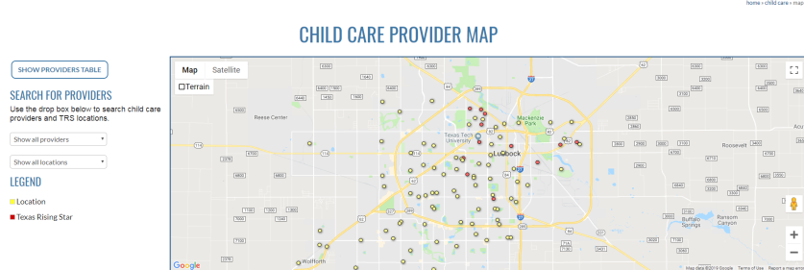
INTERACTIVE MAPS
BENEFITS
Great at Promoting Locations & Keeping Audience Engaged with Memorable Experience
Takes seconds to update with real data
Mobile Friendly

Slide 12
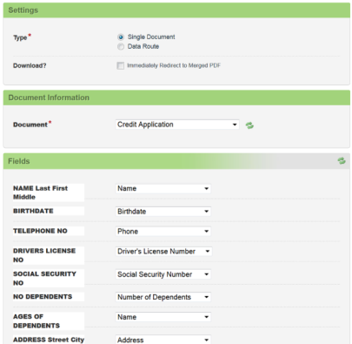
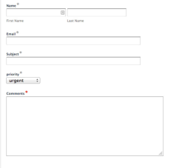
ONLINE SECURED FORMS
BENEFITS
Automated Process for Audience
Saves Effort and Reduces Errors
Improves Quality of Submitted Applications
Data submitted integrates easily into workflow processes
Minimal Administrative Overhead
Improves Data Management

Slide 13
Video content
BENEFITS
Videos Boost Conversion Rates
Personalizes Messaging
Showcases Personality
Helps Establish You as a Technology Adopter
Increases Brand Awareness
Improves Search Engine Ranking

Slide 14
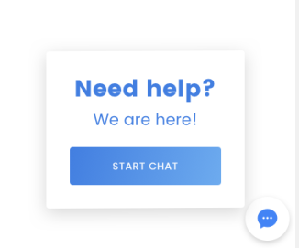
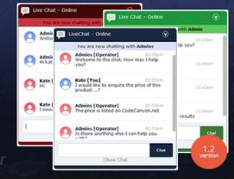
ONLINE CHAT FEATURE
BENEFITS
Improves Client Service
Discover Client Pain Points
Create a 2 way Communication
Client Convenience
Shows Level of Commitment to Clients

Slide 15
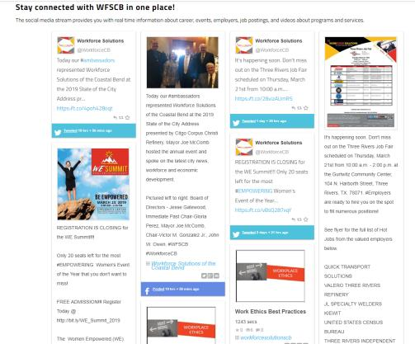
SOCIAL MEDIA INTEGRATION
BENEFITS
Great at Promoting Locations & keeping audience Engaged with Memorable Experience
Takes seconds to update with real data
Mobile Friendly

Slide 16
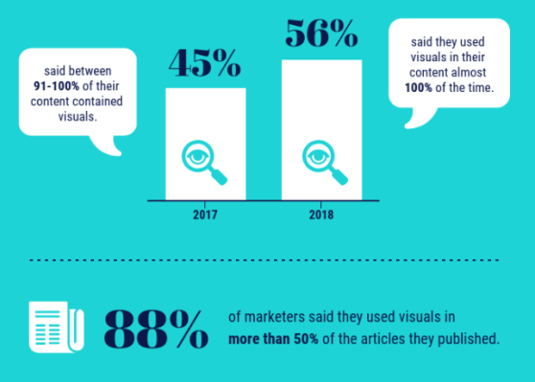
Quick stats
VIDEO CONTENT

Slide 17
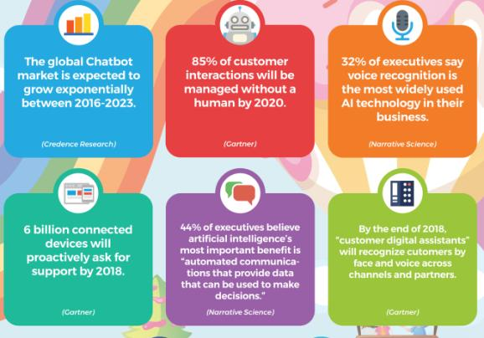
Quick stats
CHAT FEATURE

Slide 18
THANK YOU.
WWW.WEBHEADTECH.COM

